Slide 1
Evolutionary Pathways to Statehood: Old Theories and New Data
Peter Turchin
February 2018

Slide 2
A (Crude) Social Scale
Social scale (people) | Polity Types | Time (kya)
10s | Foraging bands | 200
100s | Farming villages | 10
1,000s | Simple chiefdoms | 7.5
10,000s | Complex chiefdoms | 7
100,000s | Archaic states | 5
1,000,000s | Macrostates | 4.5
10,000,000s | Mega-empires | 2.5
100,000,000s | Large nation-states | 0.2

Slide 3
Evolution of the State: A Multitude of Theories
Functionalist theories
develop and maintain infrastructure
irrigation (Wittfogel 1957)
economic management
long-distance trade (Rathje 1971)
risk management (Johnson and Earle 2000)
Conflict theories
internal conflict
class struggle (Engels 1884)
external conflict (warfare)
conquest (Oppenheimer 1975)
circumscription (Carneiro 1970)
… and many more
Notes:
3

Slide 4
Testing theories with Seshat data
Response variable: specialized governance
the state (def): a politically centralized territorial polity with internally specialized administrative organization
Predictor variables:
Social scale
polity population
polity territory
population of the largest settlement
Proxies for other potential evolutionary forces
stratification
provision of public goods
Possible “pre-conditions”
information systems
money
Notes:
4

Slide 5
Plan
An introduction to the Seshat Databank
Testing a subset of theories about the evolution of specialized governance
Other questions and future directions
Notes:
5

Slide 6
SESHAT: Global History Databank
The huge corpus of knowledge about past societies collectively possessed by academic historians is almost entirely in a form that is inaccessible to scientific analysis, stored in historians’ brains or scattered over heterogeneous notes and publications. The huge potential of this knowledge for testing theories about political and economic development has been largely untapped.
Project goals:
Build a web of facts about past societies, connected along spatial, temporal, and conceptual dimensions
Survey diversity in social evolutionary trajectories and identify general patterns
Test and reject theories of sociocultural evolution

Slide 7
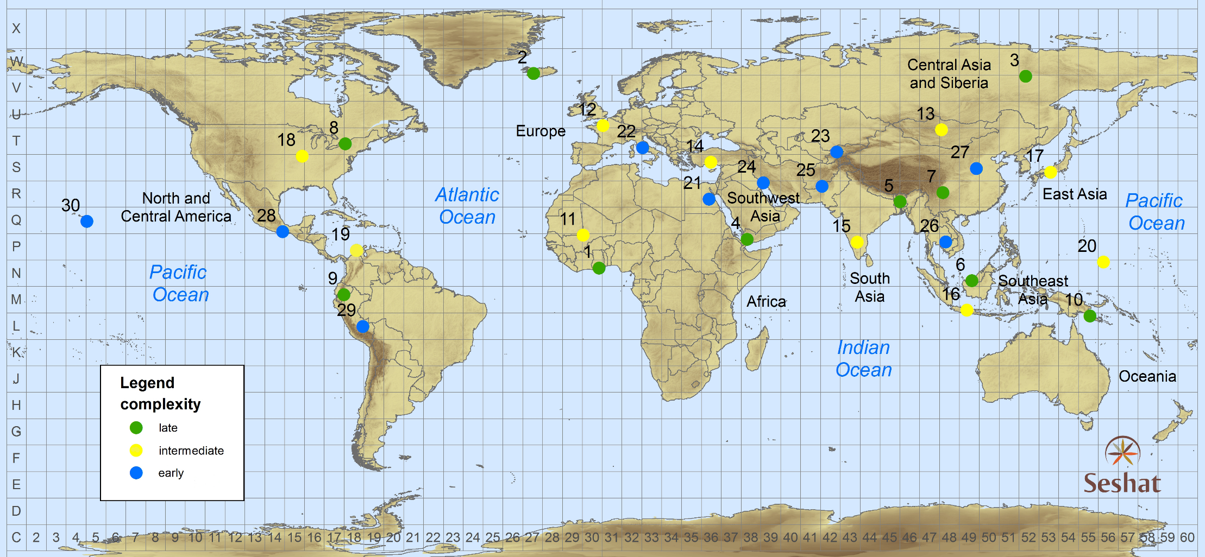
World Sample-30
Seshat: The Global
History Databank
Notes:
- sample societies from around the globe

Slide 8
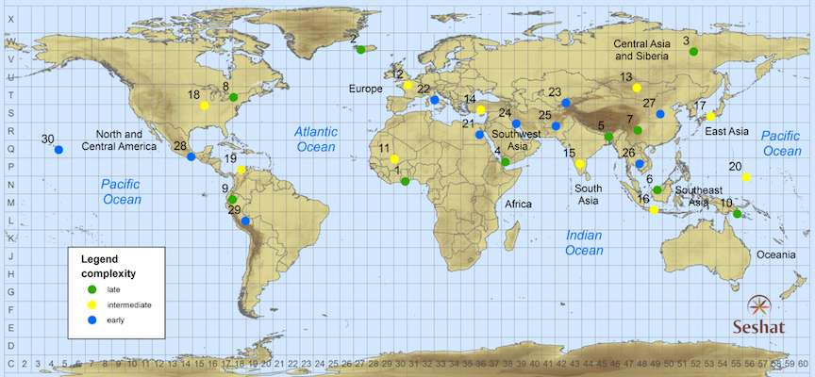
A Global Sample of the Historical and Archaeological Record
Polity | Start date | End date
Badarian | -4400 | -3801
Naqada IA-IIB | -3800 | -3551
Naqada IIC-D | -3550 | -3301
Dynasty 0 (Naqada IIIA-B) | -3300 | -3101
Dynasty I (Naqada IIIC) | -3100 | -2901
Dynasty II (Early Dynastic) | -2900 | -2651
Classic Old Kingdom | -2650 | -2351
Late Old Kingdom | -2350 | -2151
First Intermediate | -2150 | -2017
Middle Kingdom | -2016 | -1700
Second Intermediate | -1720 | -1567
New Kingdom-Thutmosid | -1550 | -1294
New Kingdom-Ramesside | -1293 | -1071
…
Ottoman Empire III | 1683 | 1839
At each sample point we code societies that occupied the area from the Neolithic to the Industrial Revolution. For example, Upper Egypt’s polities range from the Badarian to the Ottoman Empire.
Constructing a spatio-temporal dataset
Seshat: The Global
History Databank

Slide 9
Data Collection: How It Works - I
Workshop: social scientists and historians develop a conceptual scheme for coding variables of interest
Theory-neutral as much as possible
of course, human cognition is “theory-based” and we need to be on guard against various theoretical biases
Break down complex characteristics into constituent components
state or non-state?
simple or complex?
Develop a detailed code book
Illustration: coding specialized governance
Notes:
9

Slide 10
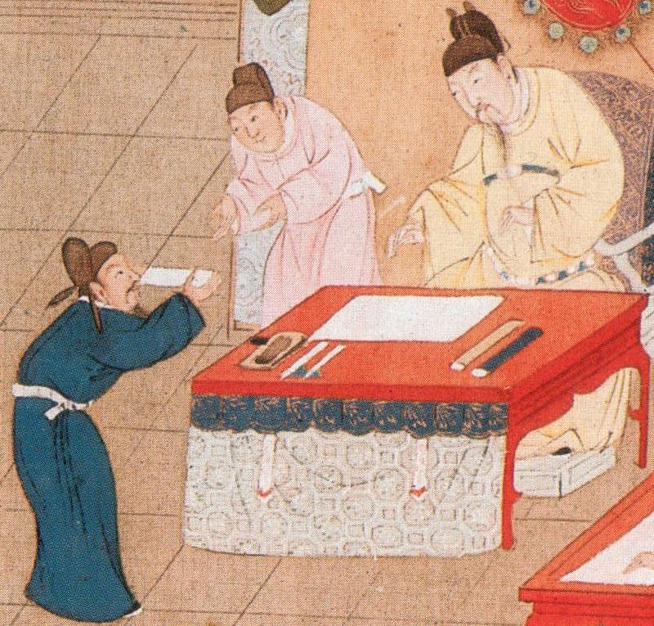
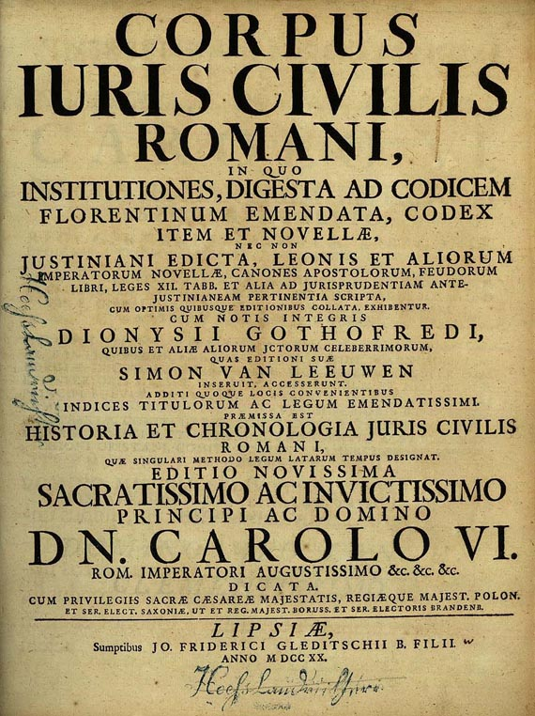
Quantifying Specialized Governance
Full-time professionals
administrative specialists (bureaucrats)
military officers
soldiers
religious specialists (priests)
Specialized government buildings
Bureaucracy characteristics
examination system
merit promotion
Legal system
formal legal code
specialized buildings (courts)
professional judges
advocates
Governance = sum of binary variables scaled to [0, 1]
The emperor receives a candidate during the Palace Examination (Song dynasty)
Notes:
10

Slide 11
Data Collection: How It Works - II
Research assistants begin coding the variables
in close collaboration with experts (academic historians and archaeologists)
The code book is repeatedly refined as we encounter different societies
We do not code more than what is known
“unknown” is a legitimate code
codes reflect uncertainty
and expert disagreement
Notes:
11

Slide 12
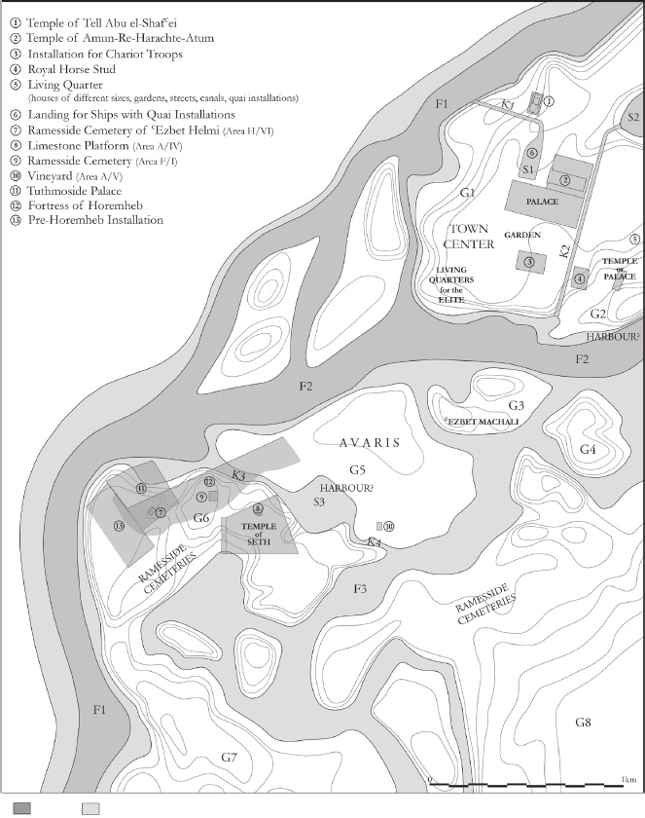
Example of a Seshat Record:
CapPop value for EgNKRam
♠ Population of the largest settlement ♣ {100,000; [250,000-300,000]} ♥
"the later Ramesside period marked a new era, when Pi-Ramesses, in the eastern Delta, became the main capital of the kingdom. The Austrian excavations are gradually revealing the huge dimensions and complexity of this metropolis of about 18km2 and 250,000–300,000 dwellers." [68]
Seshat Workshop on Egypt (Oxford, 2014): Bietak estimates that the population of Pi-Ramesses was around 250,000.
John Baines (Jan. 2017): can’t be more than 100k
Per-Ramesses topography - should be up-to-date hectare estimates in [69] →

Slide 13
Seshat Status, Feb. 2018
34 NGAs
450 (quasi)polities
1500 variables
>200,000 Seshat records
5,000,000 triples (RDF)

Slide 14
Plan
An introduction to the Seshat Databank
Testing a subset of theories about the evolution of specialized governance
Other questions and future directions
Notes:
14

Slide 15
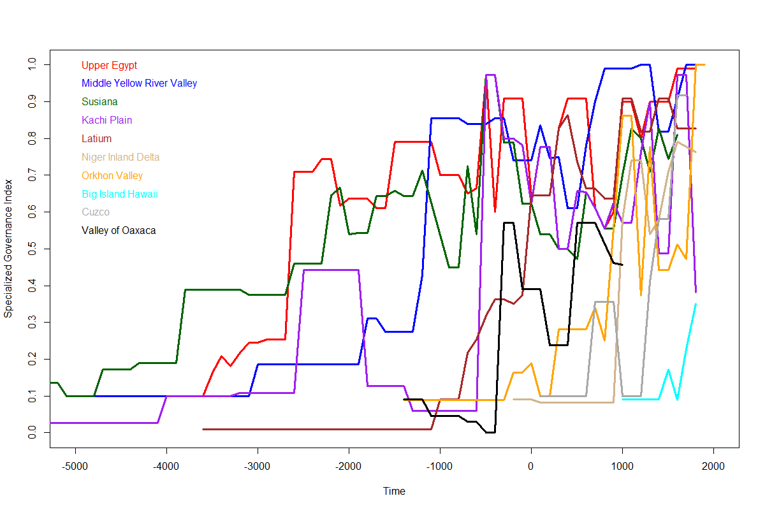
Specialized governance trajectories in 10 world regions

Slide 16
Hypotheses: Social Scale Effects
Polity population (e.g. Herbert Spencer)
larger groups of people require more potent mechanisms for coordination and integration
resolve disputes; prevent/punish free riding
Polity territory (e.g. Charles Spencer)
distant populations require delegated authority
specialized subordinates less likely to rebel
Urban population (e.g. Raoul Narroll)
large cities => greater specialization and, more generally, greater social complexity
Notes:
16

Slide 17
Other possible drivers
Stratification as a proxy for internal conflict theories
more hierarchical levels => more power accruing to the leaders (Robert Michels)
the state evolves to protect the interests of the powerful and wealthy
Quantifying hierarchy by the number of levels
in military chains of command
in administrative hierarchies
in religious hierarchies
in settlement hierarchies (an archaeological proxy)
Notes:
17

Slide 18
Other possible drivers
“Infrastructure” as a proxy for managerial theories
building and maintaining infrastructure providing public goods requires high degree of coordination, free-rider control
Quantifying infrastructure/public goods provision
irrigation systems
water supply systems, food storage structures
roads, bridges, canals, ports, markets
courier service, postal stations, a general postal system
Notes:
18

Slide 19
Pre-conditions or “pre-adaptations”
Information systems: records, bureaucracy
mnemomics (tallies), nonwritten records (quipu), script (short inscriptions), written records
number of text kinds: lists, calendar, sacred texts, religious literature, practical literature, history, philosophy, science, fiction
Money: tax collection, market economy
articles (cattle), tokens (cowries), precious metals, foreign coins, indigenous coins, paper currency
Notes:
19

Slide 20
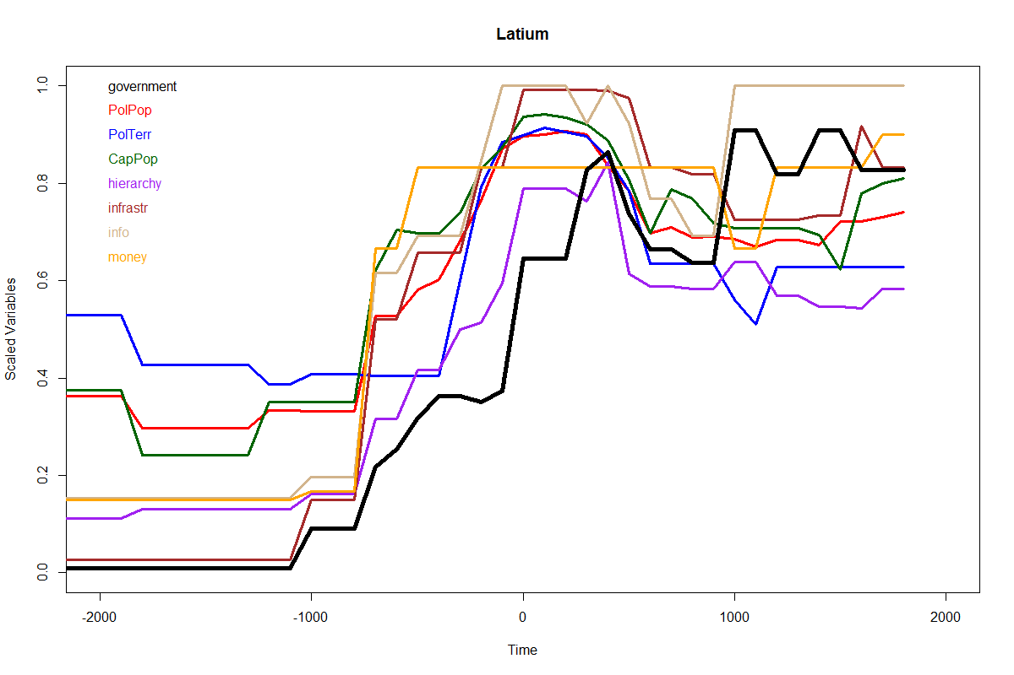
Dynamics of different variables in one region
Turchin et al. 2018. Quantitative historical analysis uncovers a single dimension of complexity that structures global variation in human social organization. PNAS 115:e144-e151.

Slide 21
Fitting Dynamical Regression Models to Seshat Data
$$Y_{i,t}=a+\sum_{τ}{b_{τ}Y_{i,t−τ}}+c\sum_{i≠j}{\exp\left[−\frac{δ_{i,j}}{d}\right]}Y_{j,t−1}+h\sum_{i≠j}{w_{i,j}}Y_{j,t−1}+\sum_{k}{g_{k}}X_{k}+ε_{i,t}$$
Y_{i,t} is the response variable: the measure of specialized governance in location i at time t
The first term captures the influences of past history (autoregressive terms)
with τ = 1, 2, … indexing time-lagged values of Y; time step Δt = 100 years.
The next term represents potential effects of geographic diffusion
δ_{i,j} is distance between society i and society j
Autocorrelations due to shared phylogenies (next term) are modeled analogously;
$w_{i,j}$ are weights reflecting linguistic similarity
The next-to-last term represents effects of predictor variables X_{k}
c_{k} are regression coefficients
Last, ε_{i,t} is the error term
Model selection by exhaustive search, selecting the best model by the AIC (Akaike Information Criterion)

Slide 22
Dynamical Regression Approach
Extracts information from both
time-resolved (time-series) data
cross-cultural aspect of the Seshat Databank
Identifies causal links between variables
avoids the problem of “endogeneity”
Detects influences due to geographic diffusion and shared phylogenies
the “Galton problem”
Tests for and models longer time lags
Tests for and models nonlinear effects
Notes:
22

Slide 23
Regression Results: Best Model (smallest AIC)
Call: glm(formula = RegrDat)
Standardized Coefficients:
Estimate Std. Error t value Pr(>|t|)
(Intercept) 0.000 0.001 0.00 1.000
governance 0.958 0.056 16.85 < 2e-16 ***
gov.sq -0.199 0.045 -4.37 0.00001 ***
Phylogeny 0.051 0.012 4.11 0.00004 ***
PolPop 0.125 0.037 3.34 0.0009 ***
PolTerr -0.057 0.025 -2.25 0.025 *
info 0.063 0.026 2.40 0.017 *
money 0.041 0.020 2.05 0.041 *
Null deviance: 87.8647 on 863 degrees of freedom
Residual deviance: 8.3468 on 856 degrees of freedom
AIC: -1538.8

Slide 24
Regression Results: Best Model (smallest AIC)
Call: glm(formula = RegrDat)
Standardized Coefficients:
Estimate Std. Error t value Pr(>|t|)
(Intercept) 0.000 0.001 0.00 1.000
governance 0.958 0.056 16.85 < 2e-16 ***
gov.sq -0.199 0.045 -4.37 0.00001 ***
Phylogeny 0.051 0.012 4.11 0.00004 ***
PolPop 0.125 0.037 3.34 0.0009 ***
PolTerr -0.057 0.025 -2.25 0.025 *
info 0.063 0.026 2.40 0.017 *
money 0.041 0.020 2.05 0.041 *
Null deviance: 87.8647 on 863 degrees of freedom
Residual deviance: 8.3468 on 856 degrees of freedom
AIC: -1538.8

Slide 25
Regression Results: Ten Best Model (by AIC)
t-statistics
Gov | Gov² | Phyl | Pop | Terr | Cap | Strat | Infr | Info | Money | R² | ΔAIC
16.85 | –4.37 | 4.11 | 3.34 | –2.25 |  |  |  | 2.40 | 2.05 | 0.91 | 0.00
16.17 | –4.18 | 4.15 | 2.44 | –2.00 | 0.78 |  |  | 2.44 | 1.99 | 0.91 | 1.39
15.97 | –4.19 | 4.11 | 2.79 | –1.97 |  |  | 0.43 | 2.43 | 1.87 | 0.91 | 1.81
16.33 | –4.35 | 4.11 | 3.12 | –2.20 |  | 0.14 |  | 2.32 | 2.05 | 0.91 | 1.98
17.55 | –4.58 | 4.87 | 3.74 | –2.54 |  |  |  | 2.88 |  | 0.90 | 2.23
18.41 | –5.16 | 3.98 | 2.56 |  |  |  |  | 2.40 | 2.37 | 0.90 | 3.08
15.46 | –4.03 | 4.15 | 2.14 | –1.79 | 0.75 |  | 0.37 | 2.46 | 1.83 | 0.91 | 3.25
16.22 | –4.25 | 4.79 | 2.85 | –2.03 |  |  | 0.94 | 2.92 |  | 0.90 | 3.33
15.97 | –4.18 | 4.15 | 2.44 | –2.01 | 0.78 | –0.14 |  | 2.40 | 1.98 | 0.91 | 3.37
16.73 | –4.35 | 4.90 | 2.67 | –2.24 | 0.92 |  |  | 2.92 |  | 0.90 | 3.38

Slide 26
Regression Results: Summary
Memory effects: very strong
captured by the first lag (it’s an AR1 process)
effect is nonlinear
Spatial diffusion: no effect detected
Phylogeny: strong effect
Polity population: strong
Population density: moderately strong
(substitutes for negative effect of territory)
Information, money systems: moderately strong
City population: weak or none
Stratification, infrastructure: no effect
Notes:
26

Slide 27
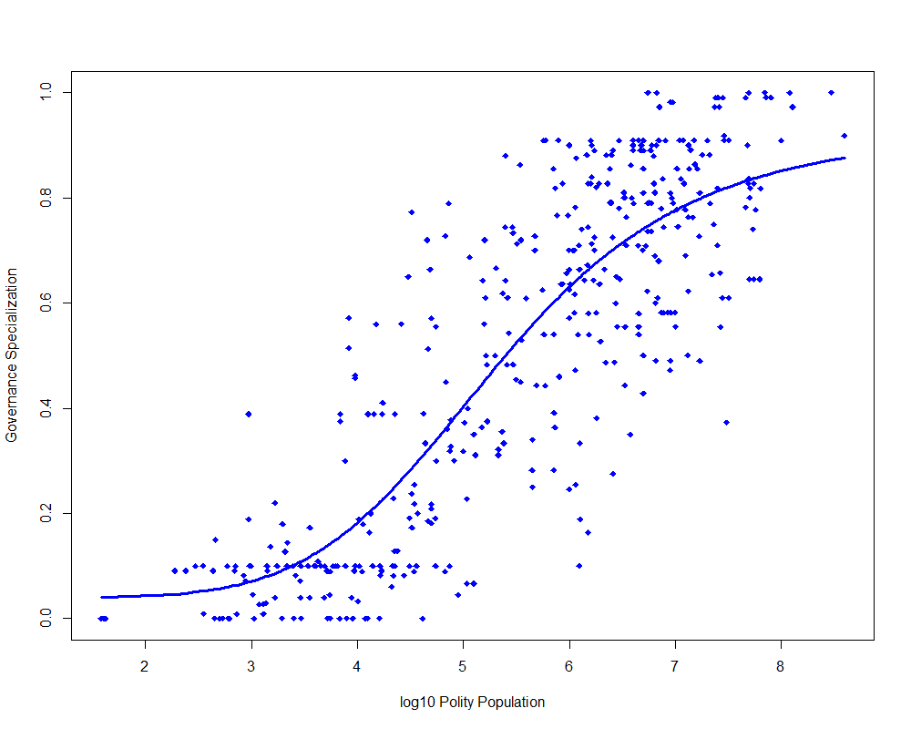
How governance coevolves with population
Model: Y = a + b X^{q}/(X^{q} + d^{q})
R² = 0.72

Slide 28
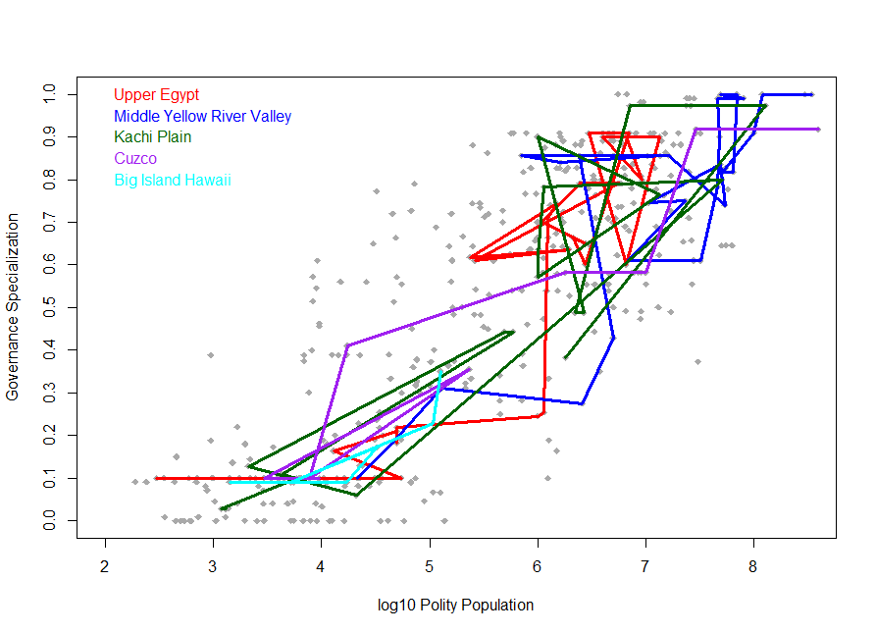

Slide 29
Plan
An introduction to the Seshat Databank
Testing a subset of theories about the evolution of specialized governance
Other questions and future directions
Notes:
29

Slide 30
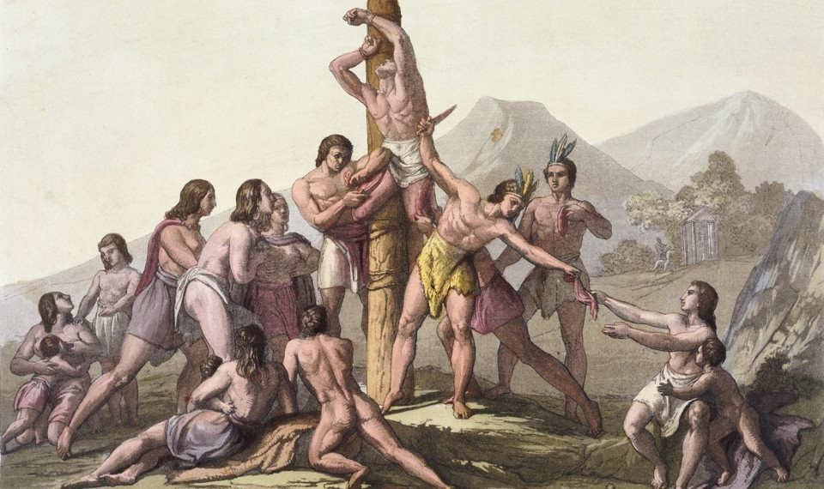
“the big-data approach to history has already provided a fascinating glimpse into the roots of social complexity”
Did Human Sacrifice Help People Form Complex Societies?
The debate over how well ritual killings maintained social order
LAURA SPINNEY February 2018

Slide 31
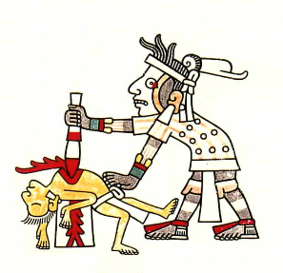
Red indicates NGAs where human sacrifice was practiced at some point in their history
The Rise and Fall of Human Sacrifice

Slide 32
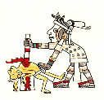
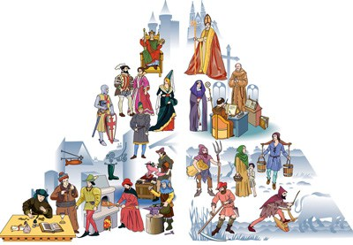
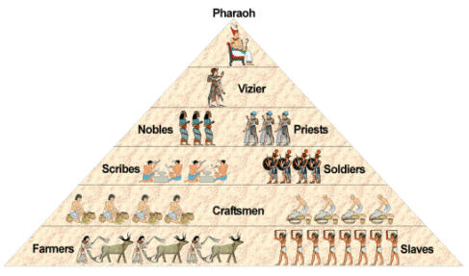
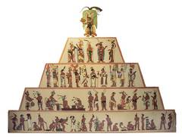
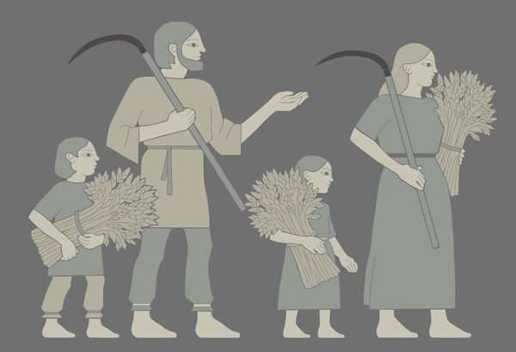
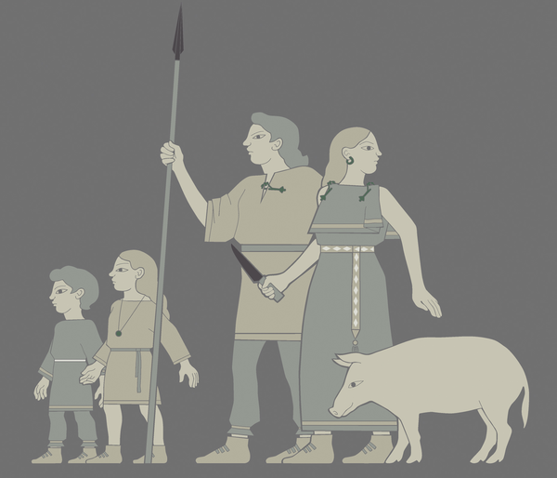
Cultural Multilevel Selection Theory predicts a nonlinear relationship: first rise, then decline of HS with social complexity
Absent or rare
Present
Absent
Human Sacrifice
Egalitarian
societies
Hierarchical class societies
Increasing Social Scale

Slide 33
Alternative Theories
Social Control Theory (Watts et al. 2016)
HS is “functional”: it promotes and stabilizes social stratification
Prediction: HS should increases as societies become more hierarchical
The “Escalator of Reason” (Pinker 2011)
superstitious killings, including HS, crumble under the scrutiny of more intellectually sophisticated populace
Prediction: HS should decrease as populations become more literate and intellectually sophisticated

Slide 34
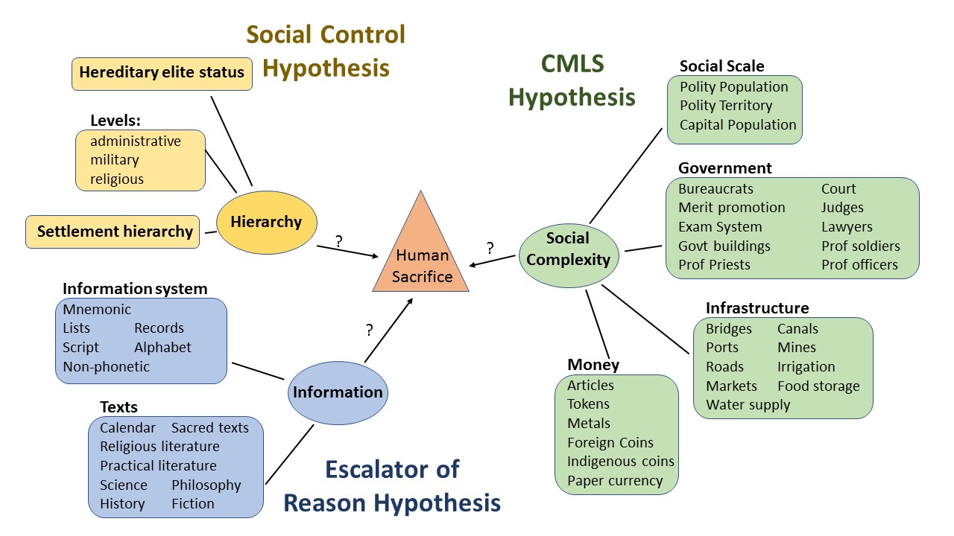

Slide 35
Regression Results
lm(formula = Y ~ ., family = binomial(link = "logit"), data=X)
Estimate Std. Error z value Pr(>|z|)
(Intercept) -4.06428 1.01583 -4.001 6.31e-05 ***
Lag1 4.81913 0.39070 12.335 < 2e-16 ***
SC1 1.09866 0.45774 2.400 0.01639 *
SC1sq -0.11253 0.03932 -2.862 0.00421 **
Hierarchy -0.14409 0.18839 -0.765 0.44439
Info -0.07647 0.09829 -0.778 0.43655
---
Signif. codes: 0 ‘***’ 0.001 ‘**’ 0.01 ‘*’ 0.05 ‘.’ 0.1

Slide 36
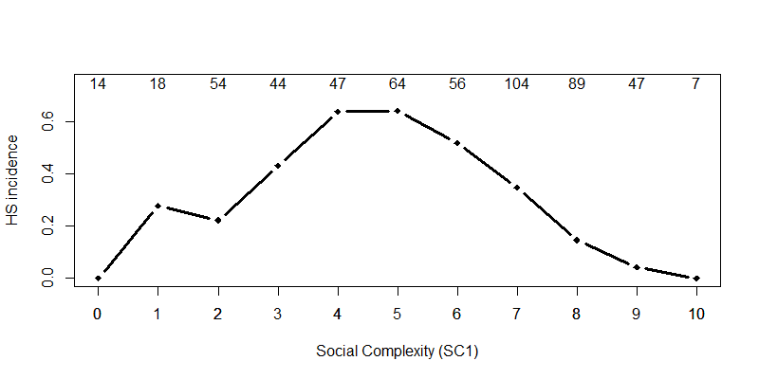
Nonlinear effect of complexity on HS

Slide 37
Other questions and future directions
Big Gods
Whitehouse et al. (submitted) Complex societies and routinised rituals precede moralising gods throughout world history
Axial Religions
Mullins et al. (submitted) A systematic assessment of “Axial Age” proposals using global comparative historical evidence
Productivity of agriculture
Collins et al. (submitted) Combining historical and archaeological data with crop models to estimate agricultural productivity in past societies
Warfare
in progress
Notes:
37

Slide 38
Conclusions
Historical data allows us to test cultural evolutionary theories
time-resolved data => causality
global sample => variance, informative data
However, many challenges remain
need to code more variables
“hidden variable problem”
need more regions
even better continuous coverage
need better statistical methods
geogr. diffusion, cultural inheritance, conquest…
Notes:
38

Slide 39
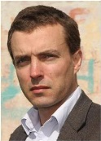
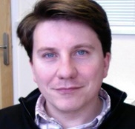
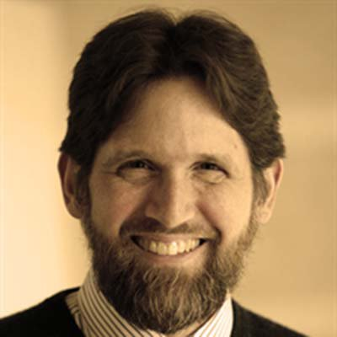
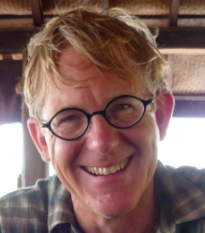
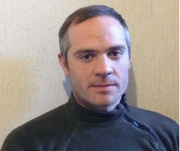
The Seshat Team
Directors
Domain Experts
Kevin Feeney Pieter Francois Harvey Whitehouse Peter Turchin
Project Manager
Research Assistants
Post-docs
Global History Databank

Slide 40
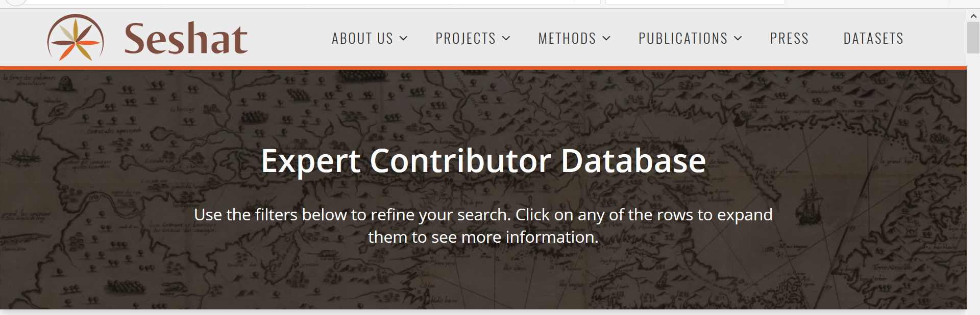
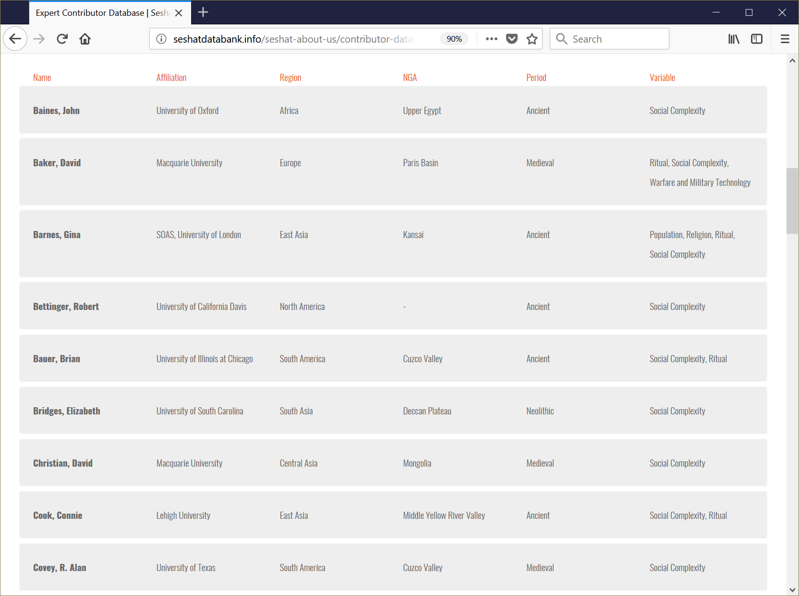

Slide 41
SESHAT: Global History Databank
Acknowledgments
Bernard Winograd
Jim Bennett
Tricoastal Foundation

